Slide 1

人工智能核心能力培养 — Lecture 04 The Kernel Ability For Artificial Intelligence
高民权

Slide 2

Review
什么是线性回归 linear regression
什么是逻辑回归 logistic regression
线性回归和逻辑回归的原理 principle of linear regression and logstic regression
机器学习/深度学习的工作量 pipeline linear of machine learning
什么是softmax, 什么是cross-entropy
什么是precision, 什么是recall，什么是auc，什么是f1, f2
什么是建模？What’s model?

Slide 3
today
过拟合与欠拟合 Underfitting and overfitting
异常值及其影响 Outlinear
常见的数据预处理及其作用 Data Pre-process
什么是one-hot编码 One-hot
线性回归与逻辑回归实战 Linear regression and logistic regression in action

Slide 4
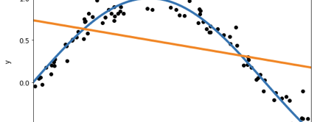
Overfitting & Underfitting
Why?

Slide 5

New
Data
特征提取
Feature extractor
Framework 机器学习的通用框架
x
1
3
2
Observed
Data
$$θ$$
Loss function
特征提取
Feature extractor
向量
vector
学习
Learning
f
Acc / precision
X1 = [0.1, 0.21,
0.33, 0.98]
Y1 = [0, 0, 1]
4
y
X2 = [0.23, 0.98,
0.33, 0.98]
Y2 = 0, 1, 0]
Gradient Descent
X3 = [0.143, 0.87,
0.1 0.98]
Y3 = [1, 0, 0]
What’s the difference of Supervised Learning and Unsupervised Learning?

Slide 6
Outliner
What’s outliner and how to detect?
Percentile（25 percentile, 75percile）

Slide 7
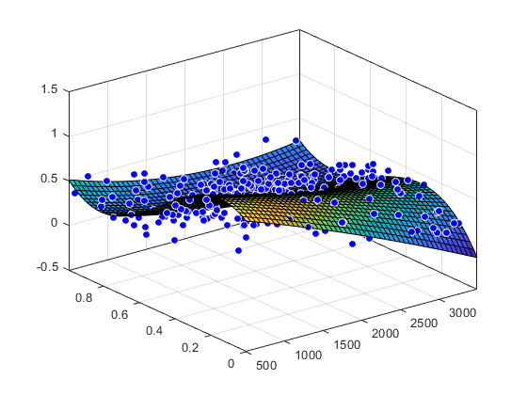
Dimension curse 维度灾难
The more dimension
The more and more … data need
过拟合 Overfitting | 欠拟合 Underfitting
训练数据占总体数据过少 | 训练数据占总体数据过多
模型过于复杂 | 模型过于简单
采样过于不均衡 | 采样过去全部
没有正则化
异常值没有处理 | 数据过于集中
… | …

Slide 8
Bias and Variance
dilemma
The bias is an error from erroneous assumptions in the learning algorithm. High bias can cause an algorithm to miss the relevant relations between feature and target outputs. (underfitting);
The variance is an error from sensitivity to small fluctuations in the training set. High variance can cause an algorithm to model the random noise in the training data, rather than the intended outputs (overfitting).

Slide 9

Feature scaling
Training data split
Normalization
Standardized
One-hot

Slide 10
Train, validation, test
Good Memory V.S Good Learning

Slide 11
Train, validation, test
Good Memory V.S Good Learning

Slide 12

数值归一化和标准化 Normalization and standardized

Slide 13
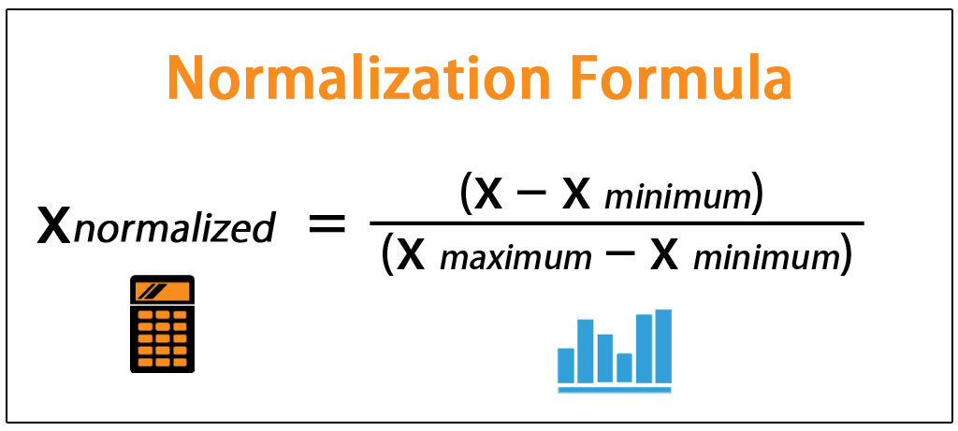
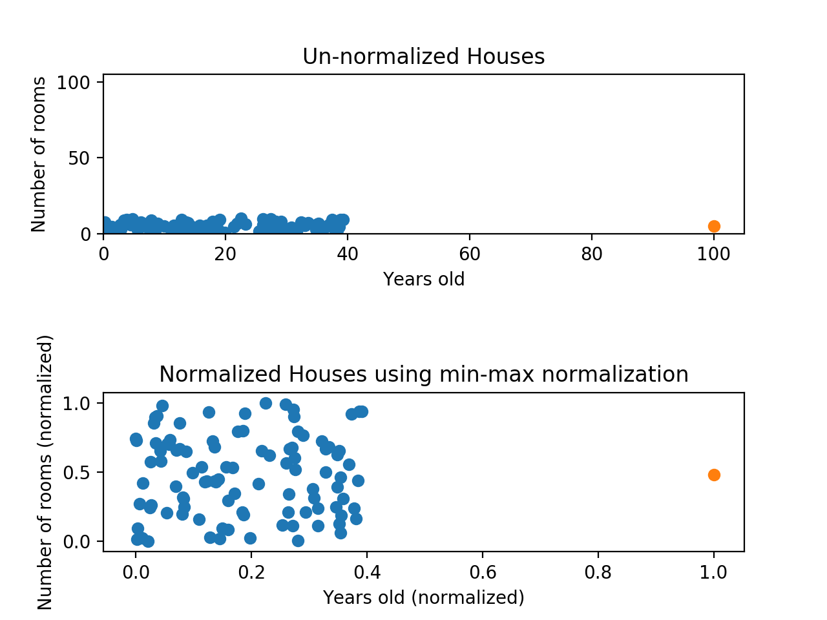
Max-min scalar (normalize)

Slide 14
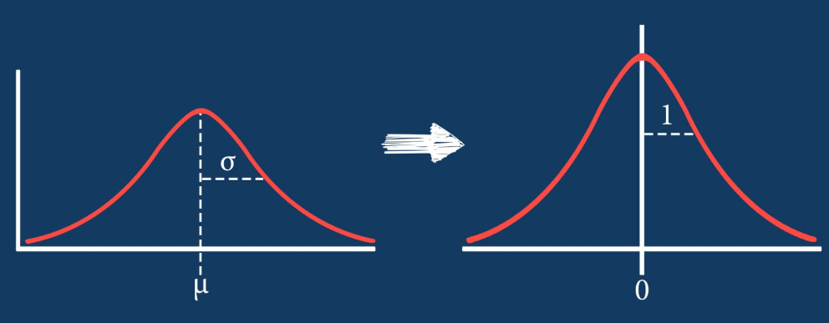
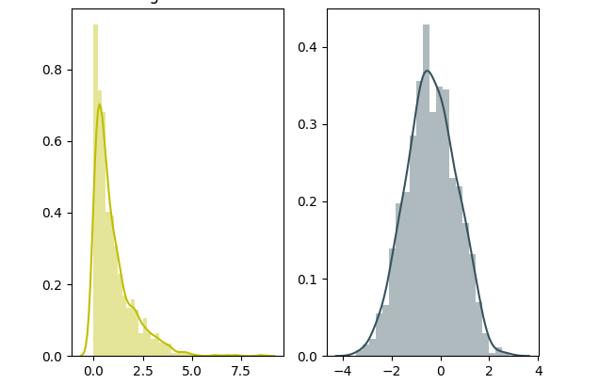
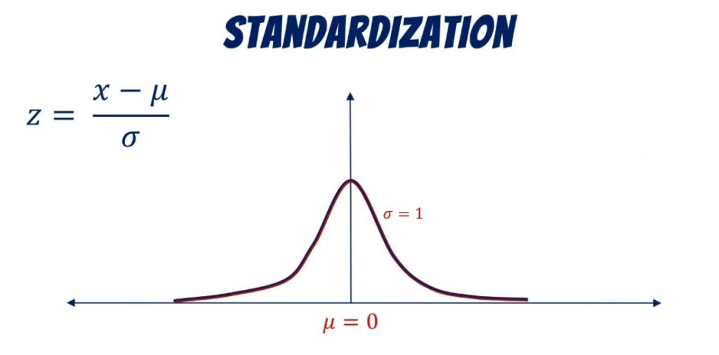
Data standardized (normalize)

Slide 15
The problem from homwwork: One-hot coding
All are numbers

Slide 16
Categorical & Numerical
What’s the different?

Slide 17
Categorical
Could not be compared
Could not be sorted
The Number just is a
representation
Numerical
Could be compared
Could be sorted
The number with attribute

Slide 18
Why it counts?

Slide 19
One-Hot and Embedding

Slide 20

Programminig 04-01
>>> one-hot
>>> normalization

Slide 21

NOW are are read for a whole classification task
现在我们已经做好准备解决完整的分类问题了

Slide 22
Programming-04-02 Linear regression principle and method
>>> implement linear regression solve house price problem
>>> the scikit learning for linear regression

Slide 23
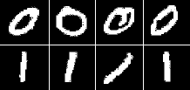
Programming – 04- 03 Binary classification problem
Biniary digital classification

